Slide 1
Reel Review
Movie Recommender
Leonardo Lopez
Michael Guynn
Nuha Aldausari

Slide 2
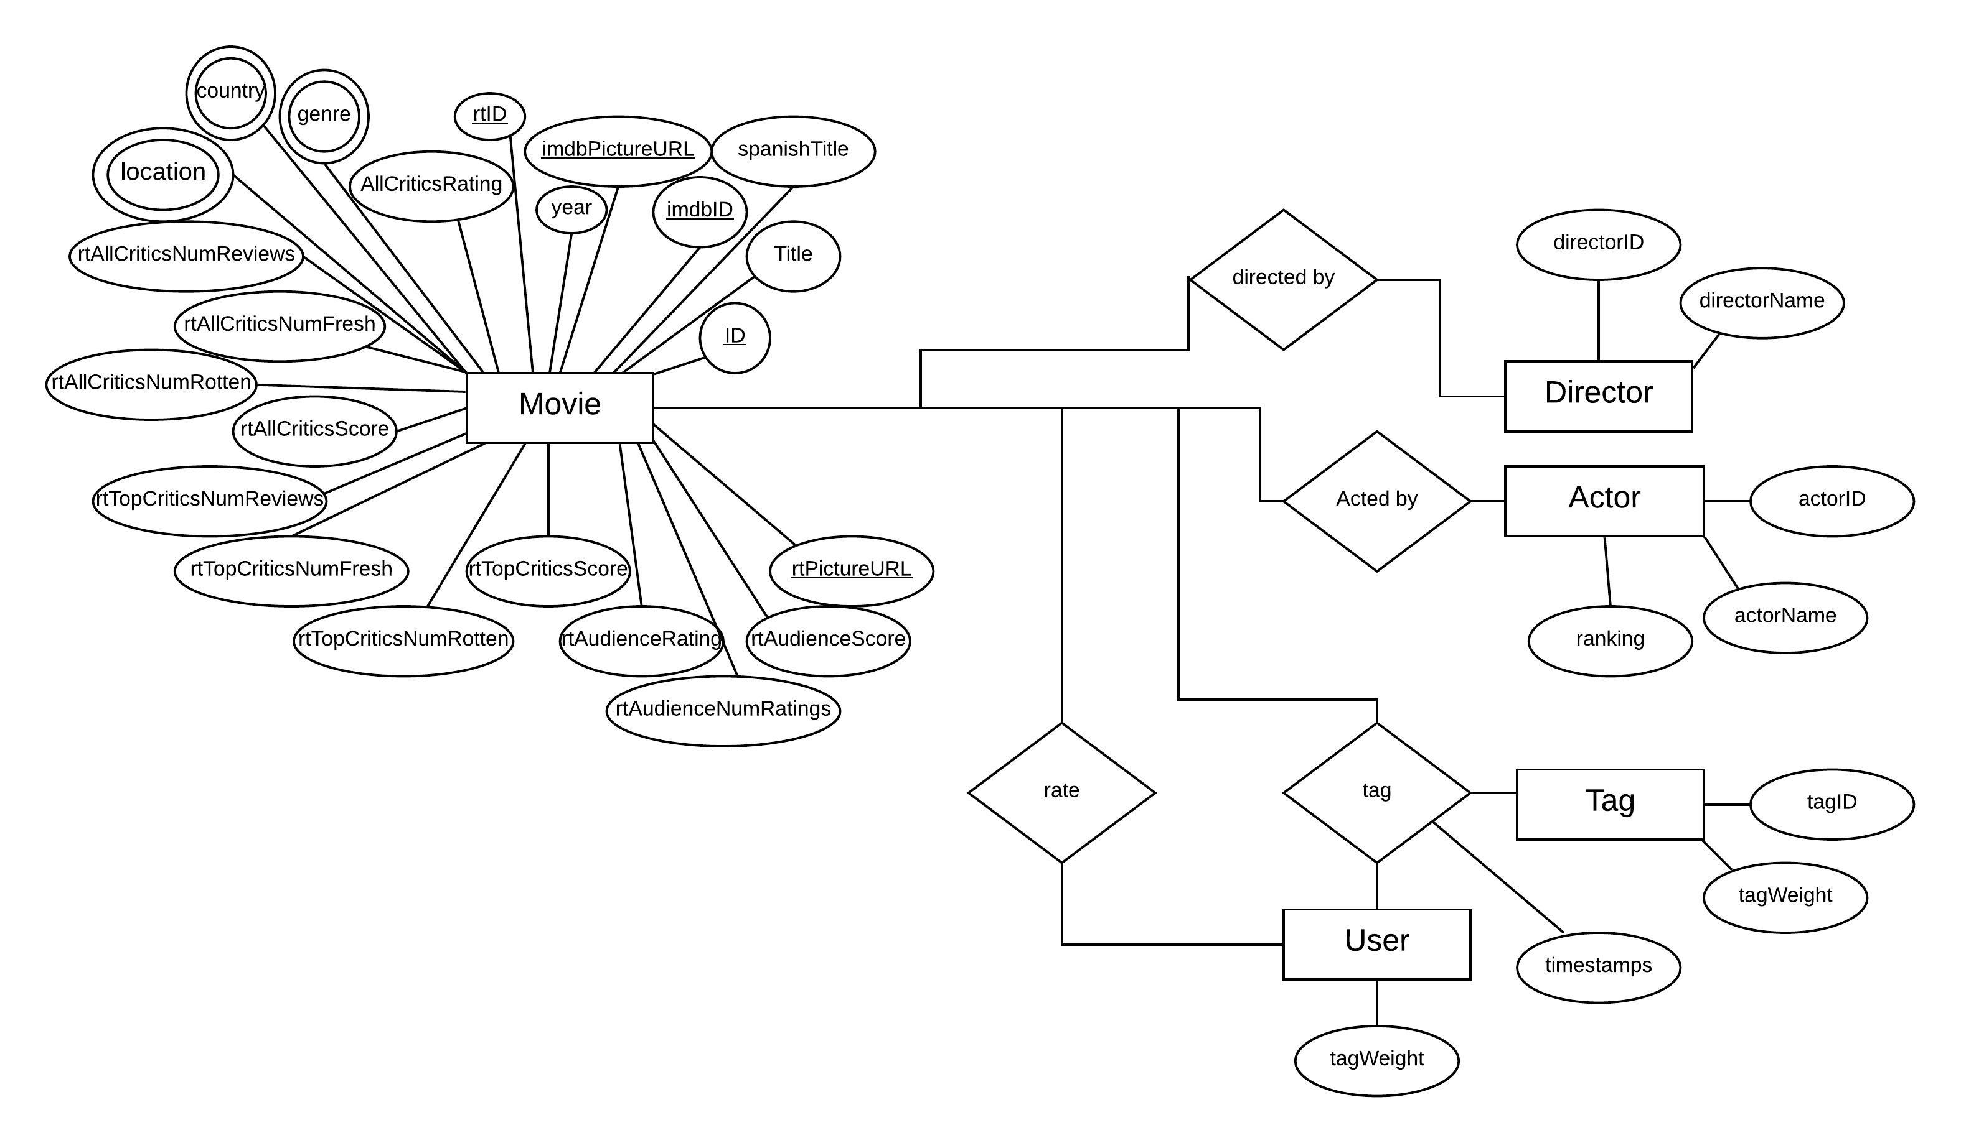
ER Diagram

Slide 3
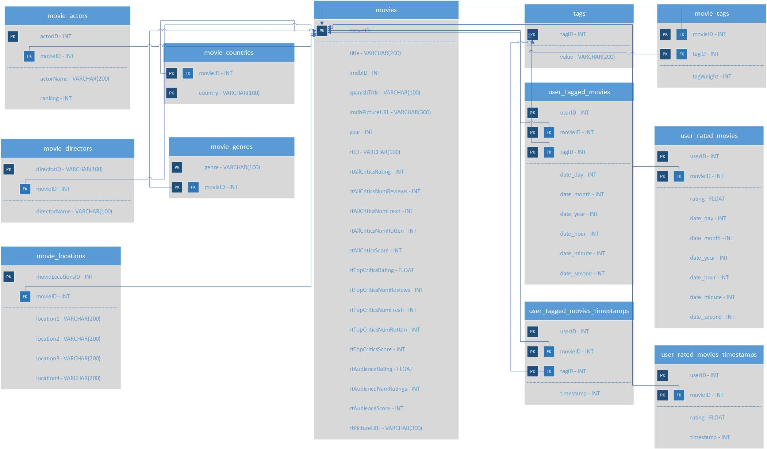
Database Schema Diagram

Slide 4
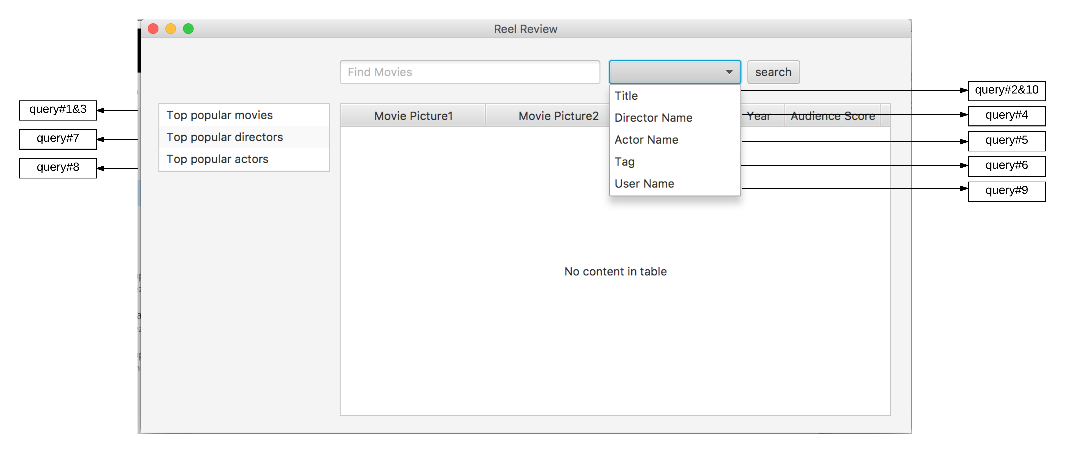
Query to User Interface Diagram

